Slide 1
INTRODUCTION
Club Membership Trend using Time Series Analysis and Regression Model

Slide 2

Objective & Motivation
Explore student participation in clubs and events over time.
Use time series analysis and regression techniques for trend analysis.
Predict future membership trends.
Provide insights for better resource allocation, event planning, and club management.
Understand how student engagement in extracurricular activities impacts their overall experience.
Optimize club activities to improve student involvement.

Slide 3
Attributes of Datasets & Its types
The dataset provided includes information about club membership trends over multiple semesters. Key attributes are:
Semester – Represents the time period (Semester 1, 2, 3, and 4).
Club Name/ID – Identifies the specific club (e.g., Club 1, Club 2, etc.).
Past Members – Number of continuing members from the previous semester.
New Members – Number of new participants who joined during that semester.
Total Members – Sum of past and new members in the current semester.
Event Attendance – Number of participants attending events hosted by the club.

Slide 4
Handing Categorical data
Why Handle It?
Machine learning models need numerical inputs, so categorical data (e.g., clubs, semesters) must be encoded.
Methods:
One-Hot Encoding: Converts categories to binary columns.
import pandas as pd
df = pd.DataFrame({'Club': ['Club1', 'Club2', 'Club3'], 'Semester': [1, 2, 3]})
df_encoded = pd.get_dummies(df, columns=['Club'])
print(df_encoded)

Slide 5
Ordinal Encoding: Maps ordered categories to integers.
from sklearn.preprocessing import OrdinalEncoder
encoder = OrdinalEncoder()
df['Semester'] = encoder.fit_transform(df[['Semester']])
print(df)

Slide 6
Relationship Between Attributes
1. Past Members and New Members
High past membership often correlates with increased new memberships due to positive club reputation and recurring participation.
2. Total Members and Event Attendance
Clubs with larger memberships often see increased participation, suggesting a stronger sense of community and interest in events.
3. New Members and Event Attendance
A steady increase in new members can predict higher event engagement over subsequent semesters.
4. Semester Progression and Membership Growth
Membership growth trends over semesters can be analyzed using time series models to identify seasonality and patterns.

Slide 7
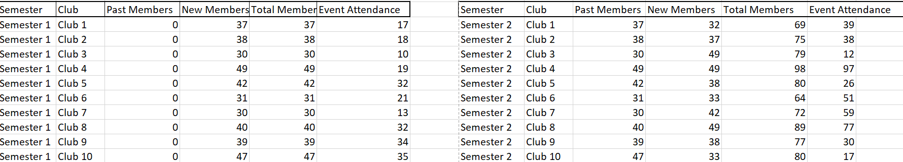
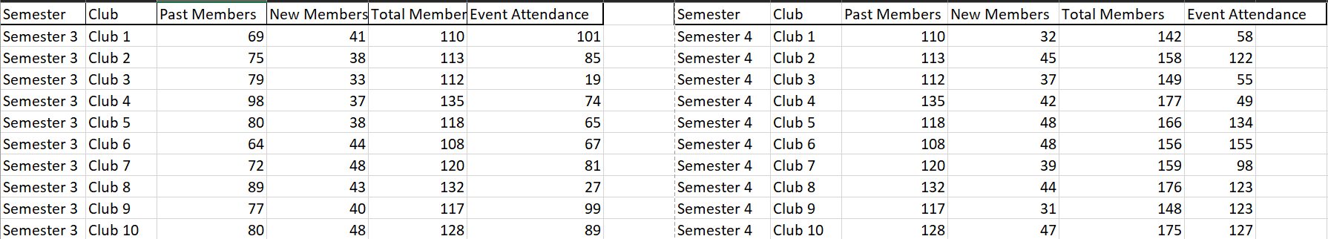
Dataset

Slide 8
Model Required
import pandas as pd
import matplotlib.pyplot as plt
import numpy as np
from sklearn.linear_model import LinearRegression
# Load dataset
data_path = "club_membership.csv"
df = pd.read_csv(data_path)
#The dataset has columns: 'Semester', 'Club', 'Total Members', 'Event Attendance'
# Pivot data for visualization
membership_trends = df.pivot(index='Semester', columns='Club', values='Total Members')
event_trends = df.pivot(index='Semester', columns='Club', values='Event Attendance')
#Club Membership Trends Over Semesters
plt.figure(figsize=(10, 5))
for club in membership_trends.columns:
plt.plot(membership_trends.index, membership_trends[club], marker='o', label=club)
plt.title("Club Membership Trends Over Semesters")
plt.xlabel("Semester")
plt.ylabel("Total Members")
plt.legend()
plt.grid()
plt.show()

Slide 9
#Event Attendance Trends Over Semesters
plt.figure(figsize=(10, 5))
for club in event_trends.columns:
plt.plot(event_trends.index, event_trends[club], linestyle='dashed', marker='s', label=club)
plt.title("Event Attendance Trends Over Semesters")
plt.xlabel("Semester")
plt.ylabel("Event Attendance")
plt.legend()
plt.grid()
plt.show()
#Membership Trends with Future Predictions
future_semesters = np.array([5, 6]).reshape(-1, 1)
predictions = {}
plt.figure(figsize=(12, 6))
for club in membership_trends.columns:
X = np.array(membership_trends.index).reshape(-1, 1)
y = membership_trends[club].values
model = LinearRegression()
model.fit(X, y)

Slide 10
pred = model.predict(future_semesters)
predictions[club] = pred
plt.plot(X, y, marker='o', label=club)
plt.plot(future_semesters, pred, linestyle='dashed')
plt.title("Club Membership Trends and Predictions")
plt.xlabel("Semester")
plt.ylabel("Membership Count")
plt.legend()
plt.grid()
plt.show()
#Actual vs Predicted Attendance Scatter Plot
X_attendance = event_trends.index.values.reshape(-1, 1)
y_attendance = event_trends.mean(axis=1).values # Averaging attendance across clubs
model_attendance = LinearRegression()
model_attendance.fit(X_attendance, y_attendance)
predicted_attendance = model_attendance.predict(X_attendance)
plt.figure(figsize=(8, 6))
plt.scatter(y_attendance, predicted_attendance, alpha=0.7)
plt.xlabel("Actual Attendance")
plt.ylabel("Predicted Attendance")
plt.title("Regression Model: Actual vs Predicted Attendance")
plt.grid()
plt.show()

Slide 11
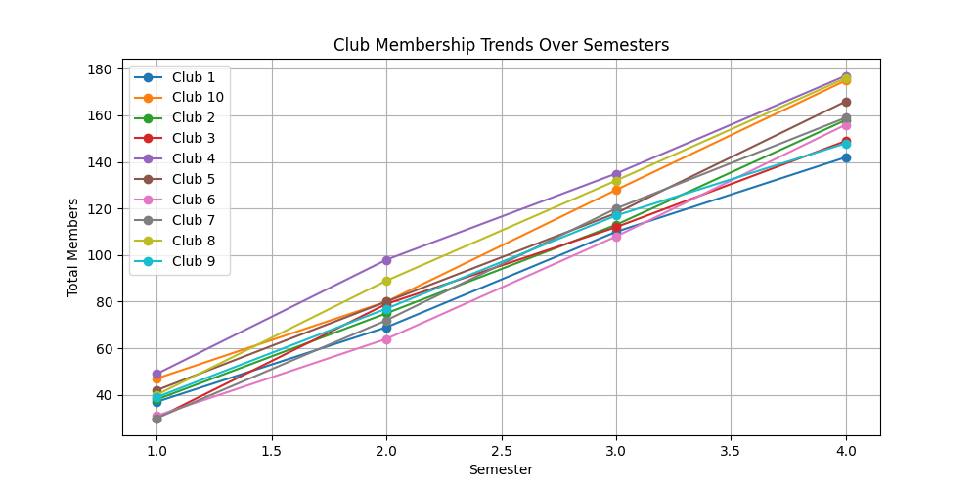
Interpretation of Model
The line graph represents the club membership trends over different semesters. Each line corresponds to a different club, showing the total number of members across four semesters. The general upward trend in all clubs indicates a consistent increase in membership over time, suggesting growing student participation. Some clubs, such as Club 1 and Club 6, exhibit a steeper growth rate, implying higher recruitment or retention rates. The trend also suggests that no clubs experienced a decline in membership, which could indicate effective engagement strategies or a growing interest in club activities among students.

Slide 12
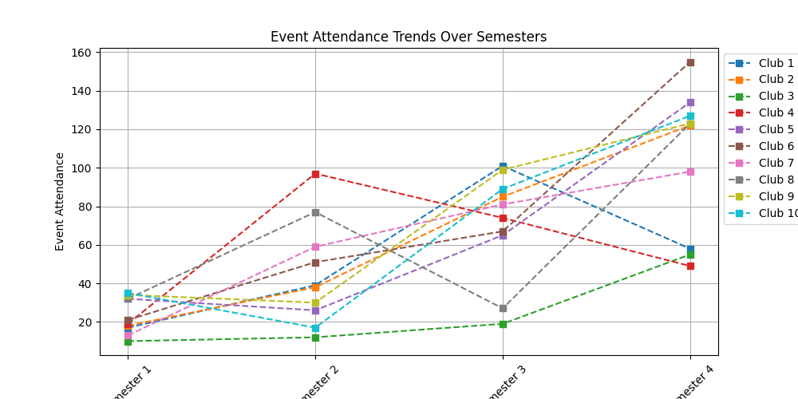
Interpretation of Model
The line graph illustrates event attendance trends over different semesters for various clubs. Unlike the previous membership graph, this one exhibits more fluctuations in attendance patterns. While most clubs show a general increase, some clubs, such as Club 4 and Club 5, demonstrate significant spikes and drops in attendance across semesters, indicating varying levels of engagement. Club 6 and Club 9 show a sharp rise in attendance by Semester 4, suggesting increased popularity or successful event planning. However, certain clubs, like Club 3, maintain relatively lower attendance, which may indicate less effective outreach or fewer events being conducted.

Slide 13
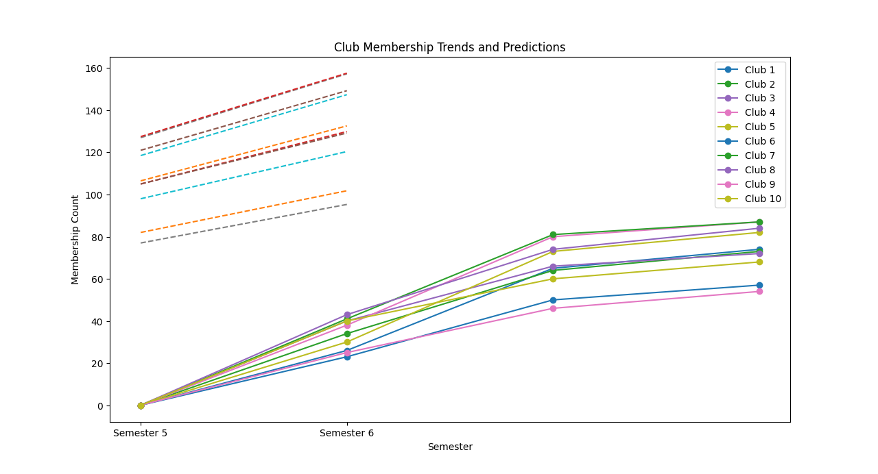
Interpretation of Model
The graph illustrates club membership trends along with predictions for future semesters. The solid lines represent actual data, while the dashed lines indicate projected membership counts. The trend shows a steady increase in club memberships over time, suggesting growing student engagement. The predicted values for upcoming semesters indicate that this trend is expected to continue, with some clubs experiencing faster growth than others. The upper set of dashed lines suggests that clubs with historically higher memberships are likely to maintain their dominance, while clubs with lower initial memberships may experience gradual but consistent growth.

Slide 14
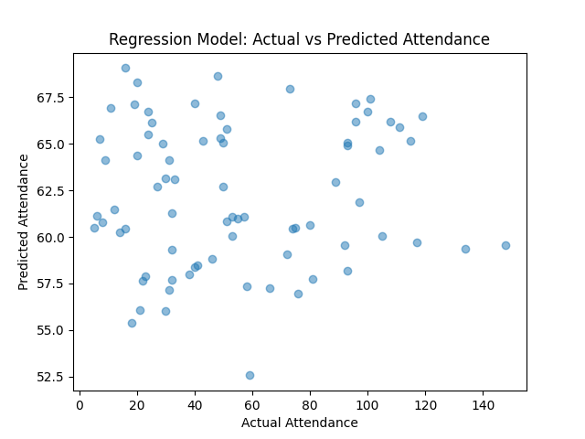
Interpretation of Model
The scatter plot compares actual event attendance with the predicted attendance based on a regression model. Ideally, if the model had perfect accuracy, the points would align along a 45-degree diagonal line (y = x). However, the spread of points indicates some deviation between actual and predicted values. While some predictions are relatively close, others show noticeable discrepancies, suggesting that the model might require further tuning to improve accuracy. Possible refinements could include incorporating additional variables or adjusting the regression parameters to minimize prediction errors.

Slide 15
Applicability
-> This model can predict future membership trends which will help deciding club budget and expenditure.
-> If certain events show consistently lower attendance than predicted, clubs can adjust marketing strategies or event formats to increase engagement.
-> University administration and club leaders can use insights from the model to allocate funding, promote high-impact events, and improve overall student engagement.
-> The model can help forecast club event attendance for future semesters, allowing organizers to plan resources, venues, and logistics more effectively.

Slide 16
Thank You
GROUP 9
-> Abhinav Anand (BTECH/10164/23)
-> Aman Agrawal (BTECH/10166/23)
-> Randhir Raj (BTECH/10216/23)
-> Shivam Sharma (BTECH/10230/23)
-> Mayank Raj (BTECH/10640/23)

